Slide 5
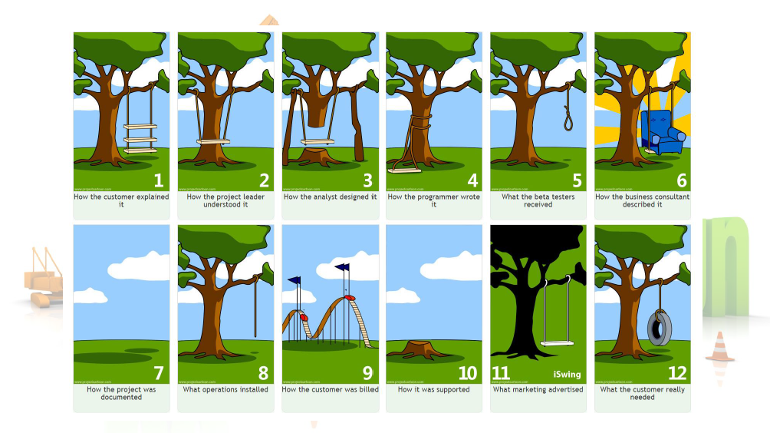

Slide 6
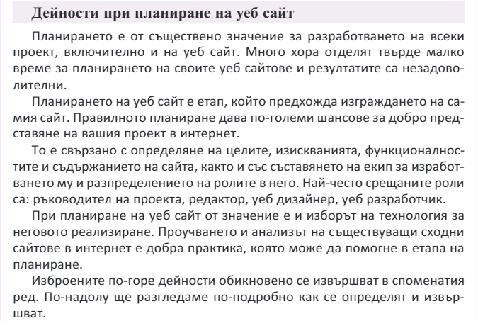

Slide 11
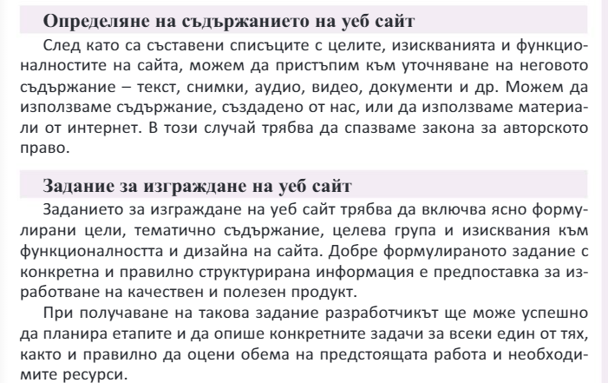

Slide 22
Онлайн ресурси то темата
https://seomax.bg/etapi-na-izrabotkata-na-website/
https://ninacrew.com/planning-on-website/
https://www.icn.bg/bg/blog/friendly-geeks-saveti/planirane-uspeshen-uebsajt/
https://alle.bg/%D1%80%D1%8A%D0%BA%D0%BE%D0%B2%D0%BE%D0%B4%D1%81%D1%82%D0%B2%D0%BE-%D0%B7%D0%B0-%D1%81%D1%8A%D0%B7%D0%B4%D0%B0%D0%B2%D0%B0%D0%BD%D0%B5-%D0%BD%D0%B0-%D1%83%D0%B5%D0%B1%D1%81%D0%B0%D0%B9%D1%82/

